Slide 1
The Marketing Environment
Chapter 3

Slide 2
Learning Objectives
LO 3-1 Summarize why it is important to examine and respond to the marketing environment.
LO 3-2 Explain how competitive factors affect an organization’s ability to compete.
LO 3-3 Articulate how economic factors influence a customer’s ability and willingness to buy products.
LO 3-4 Identify the types of political forces in the marketing environment.
LO 3-5 Explain how laws, government regulations, and self-regulatory agencies affect marketing activities.
LO 3-6 Describe how new technology impacts marketing and society.
LO 3-7 Outline the sociocultural issues marketers must deal with as they make decisions.

Slide 3
Environmental Forces
Environmental forces
Competitive forces
Political forces
Legal and regulatory forces
Technological forces
Sociocultural forces

Slide 4
Environmental Scanning and Analysis
Environmental scanning – The process of collecting information about forces in the marketing environment
  Involves:
    Observation
    Secondary sources such as business, trade, government, and general-interest publications
    Marketing research
  The internet has become a popular scanning tool because it makes data more
  accessible and allows companies to gather needed information quickly
Environmental analysis – The process of accessing and interpreting the information gathered through environmental scanning
  A manager evaluates the information for accuracy, tries to resolve inconsistencies in the data, and, if warranted, assigns significance to the findings
    Evaluating this information should enable the manager to identify potential threats and opportunities

Slide 5
Responding to Environmental Forces
Marketers take two general approaches to environmental forces:
  Passive – Accepting them as uncontrollable
  Proactive – Attempting to influence and shape them
There is no best way to react
  Depends on the organization’s managerial philosophies, objectives, financial resources, customers, and human resources skills, as well as the environment within which the organization operates

Slide 6
Competitive Forces
Competition – Other organizations that market products that are similar to or can be substituted for a marketer’s products in the same geographic area
  Few firms, if any, operate free of competition
  When marketing managers define the target market(s) their firm will serve, they simultaneously establish a set of competitors
  Marketing managers must consider the type of competitive structure in which the firm operates

Slide 7
Types of Competitors (slide 1 of 2)
Competitors can be classified into one of four types:
  Brand competitors – Firms that market products with similar features and benefits to the same customers at similar prices
  Product competitors – Firms that compute in the same product class but market products with different features, benefits, and prices
  Generic competitors – Firms that provide very different products that solve the same problem or satisfy the same basic customer need
  Total budget competitors – Firms that compete for the limited financial resources of the same customers

Slide 8
Types of Competitive Structures
Monopoly – A competitive structure in which an organization offers a product that has no close substitutes, making that organization the sole source of supply
  Because the organization has no competitors, it controls the supply of the product completely and, as a single seller, can erect barriers to potential competitors
Oligopoly – A competitive structure in which a few sellers control the supply of a large proportion of a product
  Usually barriers of some sort make it difficult to enter the market and compete with oligopolies
Monopolistic competition – A competitive structure in which a firm has many potential competitors and tries to develop a marketing strategy to differentiate its product
Pure competition – A market structure characterized by an extremely large number of sellers, none strong enough to significantly influence price or supply
  Products would be homogeneous, and entry into the market would be easy
  Does not exist in the real world

Slide 9
Table 3.1 – Selected Characteristics of Competitive Structures
Type of Structure | Number of Competitors | Ease of Entry into Market | Product | Example
Monopoly | One | Many barriers | Almost no substitutes | Water utilities
Oligopoly | Few | Some barriers | Homogeneous or differentiated (with real or perceived differences) | UPS, FedEx, U.S. Postal Service (package delivery)
Monopolistic competition | Many | Few barriers | Product differentiation, with many substitutes | Wrangler, Levi Strauss, Diesel, Lee Jeans (jeans)
Pure competition | Unlimited | No barriers | Homogeneous products | Vegetable farm (sweet corn)

Slide 10
Monitoring Competition
Marketers need to monitor the actions of major competitors to determine what specific strategies competitors are using and how these strategies affect their own
The firm must develop a system for gathering ongoing information about competitors and potential competitors
  Information about competitors allows marketing managers to assess the performance of their own marketing efforts and to recognize the strengths and weaknesses in their own marketing strategies

Slide 11
Economic Conditions
Changes in general economic conditions affect (and are affected by):
  Supply and demand
  Buying power
  Willingness to spend
  Consumer expenditure levels
  Intensity of competitive behavior
Business cycle – A pattern of economic fluctuations that has four stages:
  Prosperity – A stage of the business cycle characterized by low unemployment and relatively high total income, which together ensure high buying power (provided the inflation rate stays low)
    Consumers generally are willing to buy, and marketers often expand their product offerings to take advantage of increased buying power
  Recession – A stage of the business cycle during which unemployment rises and total buying power declines, stifling both consumer and business spending
  Depression – A stage of the business cycle when unemployment is extremely high, wages are very low, total disposable income is at a minimum, and consumers lack confidence in the economy
  Recovery – A stage of the business cycle in which the economy moves from depression or recession to prosperity
    Difficult to ascertain how quickly and to what level prosperity will return
    Marketers should maintain as much flexibility in their marketing strategies as possible so they can make the needed adjustments

Slide 12
Buying Power (slide 1 of 2)
Buying power – Resources, such as money, goods, and services, that can be traded in an exchange
The major financial sources of buying power are income, credit, and wealth
Income – For an individual, the amount of money received through wages, rents, investments, pensions, and subsidy payments for a given period
Disposable income – After-tax income
Discretionary income – Disposable income available for spending and saving after an individual has purchased the basic necessities of food, clothing, and shelter

Slide 13
Buying Power (slide 2 of 2)
Credit enables people to spend future income now or in the near future
Credit increases current buying power at the expense of future buying power
Factors affecting credit use:
  Must be available
  Interest rates
  Credit terms (such as size of the down payment and amount and number of monthly payments)
Wealth – The accumulation of past income, natural resources, and financial resources
  Global wealth is increasing
  Like income, wealth is unevenly distributed
As people become wealthier, they gain buying power in three ways:
  To make current purchases
  To generate income
  To acquire large amounts of credit

Slide 14
Willingness to Spend
Willingness to spend – An inclination to buy because of expected satisfaction from a product, influenced by the ability to buy and numerous psychological and social forces
  Factors that affect consumers’ general willingness to spend are:
    Expectations about future employment
    Income levels
    Prices
    Family size
    General economic conditions

Slide 15
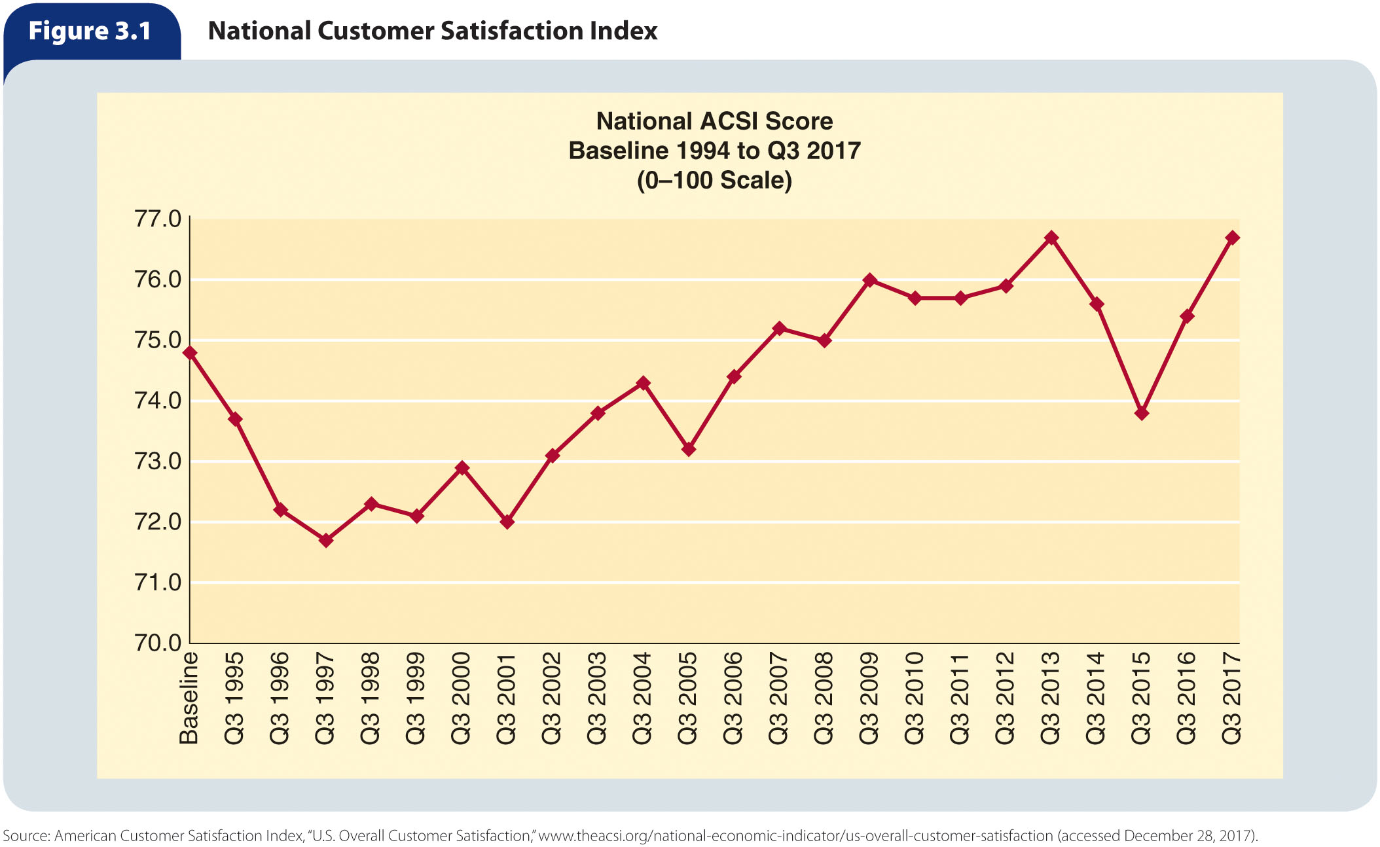
Figure 3.1 – National Customer Satisfaction Index

Slide 16
Political Forces
Political, legal, and regulatory forces of the marketing environment are closely interrelated
  Legislation is enacted
  Legal decisions are interpreted by courts
  Regulatory agencies are created and operated, for the most part, by elected or appointed officials
Marketers may:
  View political forces as beyond their control and simply adjust to conditions that arise from those forces
  Influence the process through contributions and lobbying

Slide 17
Legal and Regulatory Forces
Self-regulatory forces
Precompetitive legislation
Consumer protection legislation
Encouraging compliance with laws and regulations
Regulatory agencies

Slide 18
Table 3.2 – Major Federal Laws That Affect Marketing Decisions (slide 1 of 5)
Act (Date Enacted) Procompetitive Legislation | Purpose
Sherman Antitrust Act (1890) | Prohibits contracts, combinations, or conspiracies to restrain trade; establishes as a misdemeanor monopolizing or attempting to monopolize
Clayton Act (1914) | Prohibits specific practices such as price discrimination, exclusive-dealer arrangements, and stock acquisitions whose effect may noticeably lessen competition or tend to create a monopoly
Federal Trade Commission Act (1914) | Created the Federal Trade Commission; also gives the FTC investigatory powers to be used in preventing unfair methods of competition
Robinson-Patman Act (1936) | Prohibits price discrimination that lessens competition among wholesalers or retailers; prohibits producers from giving disproportionate services or facilities to large buyers
Wheeler-Lea Act (1938) | Prohibits unfair and deceptive acts and practices regardless of whether competition is injured; places advertising of foods and drugs under the jurisdiction of the FTC

Slide 19
Table 3.2 – Major Federal Laws That Affect Marketing Decisions (slide 2 of 5)
Act (Date Enacted) Procompetitive Legislation | Purpose
Lanham Act (1946) | Provides protections for and regulation of brand names, brand marks, trade names, and trademarks
Celler-Kefauver Act (1950) | Prohibits any corporation engaged in commerce from acquiring the whole or any part of the stock or other share of the capital assets of another corporation when the effect substantially lessens competition or tends to create a monopoly
Fair Packaging and Labeling Act (1966) | Makes illegal the unfair or deceptive packaging or labeling of consumer products
Magnuson-Moss Warranty (FTC) Act (1975) | Provides for minimum disclosure standards for written consumer product warranties; defines minimum consent standards for written warranties; allows the FTC to prescribe interpretive rules in policy statements regarding unfair or deceptive practices
Consumer Goods Pricing Act (1975) | Prohibits the use of price-maintenance agreements among manufacturers and resellers in interstate commerce.

Slide 20
Table 3.2 – Major Federal Laws That Affect Marketing Decisions (slide 3 of 5)
Act (Date Enacted) Procompetitive Legislation | Purpose
Foreign Corrupt Practices Act (1977) | Prohibits American companies from making illicit payments to foreign officials in order to obtain or keep business
Trademark Counterfeiting Act (1980) | Imposes civil and criminal penalties against those who deal in counterfeit consumer goods or any counterfeit goods that can threaten health or safety
Trademark Law Revision Act (1988) | Amends the Lanham Act to allow brands not yet introduced to be protected through registration with the Patent and Trademark Office
Nutrition Labeling and Education Act (1990) | Prohibits exaggerated health claims; requires all processed foods to contain labels with nutritional information
Telephone Consumer Protection Act (1991) | Establishes procedures to avoid unwanted telephone solicitations; prohibits marketers from using an automated telephone dialing system or an artificial or prerecorded voice to certain telephone lines

Slide 21
Table 3.2 – Major Federal Laws That Affect Marketing Decisions (slide 4 of 5)
Act (Date Enacted) Procompetitive Legislation | Purpose
Federal Trademark Dilution Act (1995) | Grants trademark owners the right to protect trademarks and requires relinquishment of names that match or parallel existing trademarks
Digital Millennium Copyright Act (1996) | Refined copyright laws to protect digital versions of copyrighted materials, including music and movies
Children’s Online Privacy Protection Act (2000) | Regulates the collection of personally identifiable information (name, address, email address, hobbies, interests, or information collected through cookies) online from children under age 13
Do Not Call Implementation Act (2003) | Directs the FCC and FTC to coordinate so their rules are consistent regarding tele-marketing call practices including the Do Not Call Registry and other lists, as well as call abandonment; in 2008, the FTC amended its rules and banned prerecorded sales pitches for all but a few cases

Slide 22
Table 3.2 – Major Federal Laws That Affect Marketing Decisions (slide 5 of 5)
Act (Date Enacted) Procompetitive Legislation | Purpose
Credit Card Act (2009) | Implements strict rules on credit card companies regarding topics such as issuing credit to youths, terms disclosure, interest rates, and fees
Dodd-Frank Wall Street Reform and Consumer Protection Act (2010) | Promotes financial reform to increase accountability and transparency in the financial industry, protects consumers from deceptive financial practices, and establishes the Bureau of Consumer Financial Protection

Slide 23
Procompetitive Legislation
Procompetitive laws are designed to preserve competition
  Most of these laws were enacted to end various antitrade practices deemed unacceptable by society
  Laws have also been created to prevent businesses from gaining an unfair advantage through bribery

Slide 24
Consumer Protection Legislation
A number of consumer protection laws deal with consumer safety and are designed to protect people from actual and potential physical harm caused by adulteration or mislabeling
Other laws prohibit the sale of various hazardous products
Others concern automobile safety
Congress has also passed several laws concerning information disclosure
Other laws focus on particular marketing activities:
  Product development and testing
  Packaging
  Labeling
  Advertising
  Consumer financing

Slide 25
Encouraging Compliance with Laws and Regulations
The current trend is moving away from legally-based organizational compliance programs
  Instead, many companies are choosing to provide incentives that foster a culture of ethics and responsibility that encourages compliance with laws and regulations

Slide 26
Regulatory Agencies
Regulatory agencies monitor many marketing activities and usually have the power to enforce specific laws, as well as some discretion in establishing operating rules and regulations to guide certain types of industry practices

Slide 27
Federal Trade Commission (FTC)
Federal Trade Commission (FTC) – An agency that regulates a variety of business practices and curbs false advertising, misleading pricing, and deceptive packaging and labeling
Most heavily influences marketing activities (of all the federal regulatory units)
Assists businesses in complying with laws and evaluates new marketing methods every year

Slide 28
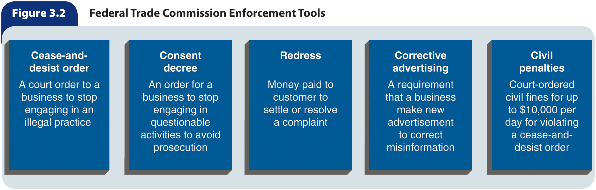
Figure 3.2 – Federal Trade Commission Enforcement Tools

Slide 29
Self-Regulatory Forces
In an attempt to be good corporate citizens and prevent government intervention, some businesses try to regulate themselves
  Better Business Bureau (BBB) – A system of nongovernmental, independent, local regulatory agencies supported by local businesses that helps settle problems between customers and specific business firms
  National Advertising Review Board (NARB) – A self-regulatory unit that considers challenges to issues raised by the National Advertising Division (an arm of the Council of Better Business Bureaus) about an advertisement
Advantages:
  Establishment and implementation are usually less expensive
  Guidelines are generally more realistic and operational
  Effective self-regulatory programs reduce the need to expand government bureaucracy
Disadvantages:
  When a trade association creates a set of industry guidelines for its members, nonmember firms do not have to abide by them
  Many self-regulatory programs lack the tools or authority to enforce guidelines
  Guidelines in self-regulatory programs are often less strict than those established by government agencies

Slide 30
Table 3.4 Self-Regulatory Issues in Marketing
 | Self-Regulatory Issues in Marketing
1 | Truthful Advertising Messages
2 | Health and Childhood Obesity
3 | Internet Tracking/User Privacy
4 | Concern for Vulnerable Populations
5 | Failure to Deliver on Expectations and Promises
6 | Sustainable Marketing Practices and Greenwashing
7 | Transparent Pricing
8 | Understandable Labeling and Packaging
9 | Supply Chain Relationships/Ethical Sourcing
10 | Marketing of Dangerous Products
11 | Product Quality Failures
12 | Nonresponse to Customer Complaints

Slide 31
Technological Forces
Technology – The application of knowledge and tools to solve problems and perform tasks more efficiently
The rapid technological growth of the last several decades is expected to accelerate

Slide 32
Impact of Technology (slide 1 of 2)
Information technology (IT) is changing the lives of consumers across the globe
  Offers lucrative career opportunities
  Provides business opportunities for entrepreneurs
  Improves supply-chain management
The importance of the internet will only increase in the future
Negative impacts include:
  Concerns over privacy
  Intellectual property protection issues

Slide 33
Impact of Technology (slide 2 of 2)
The effects of technology relate to such characteristics as dynamics, reach, and the self-sustaining nature of technological progress
  The dynamics of technology involve the constant change that often challenges the structures of social institutions, including:
    Social relationships
    The legal system
    Religion
    Education
    Business
    Leisure
  Reach refers to the broad nature of technology as it moves through society
  The self-sustaining nature of technology relates to the fact that technology acts as a catalyst to spur even faster development
  The expanding opportunities for e-commerce, the sharing of business information, the ability to maintain business relationships, and the ability to conduct business transactions via digital networks are changing the relationship between businesses and consumers

Slide 34
Adoption and Use of Technology
Firms must keep up with technological changes to maintain their status as market leaders
The extent to which a firm can protect inventions that stem from research also influences its use of technology
  If groundbreaking products and processes cannot be protected through patents, a company is less likely to market them and make the benefits of its research available to competitors
Through a procedure known as technology assessment, managers try to foresee the effects of new products and processes on their firm’s operations, on other business organizations, and on society in general
  With information obtained through a technology assessment, management tries to estimate whether benefits of adopting a specific technology outweigh costs to the firm and to society at large

Slide 35
Sociocultural Forces
Sociocultural forces – The influences in a society and its culture(s) that change people’s:
  Attitudes
  Beliefs
  Norms
  Customs
  Lifestyles
These forces help determine what, where, how, and when people buy products

Slide 36
Demographic and Diversity Characteristics
Changes in a population’s demographic characteristics lead to changes in how people live and consume products
  Increasing proportion of older consumers and singles
  Declining birth rate
  Growing number of immigrants
A more diverse customer base means marketing practices must be modified and diversified to meet its changing needs

Slide 37
Table 3.5 The Multicultural Nature of the U.S. Population
Race | % Population 2015 | Estimated % 2065
White | 62 | 46
Hispanic | 18 | 24
Black or African American | 12 | 13
Asian | 6 | 14

Slide 38
Cultural Values
Changes in cultural values dramatically influence people’s needs and desires for products
  Health, nutrition, and exercise are growing in importance (sales of organic foods, herbs and herbal remedies, vitamins, and dietary supplements have escalated)
  Values regarding the permanence of marriage are changing
  Children continue to be very important
  The trend toward eat-out and take-out meals
  Green marketing helps establish long-term consumer relationships by maintaining, supporting, and enhancing the natural environment

Slide 39
Consumerism
Consumerism – Organized efforts by individuals, groups, and organizations to protect consumers’ rights
The movement’s major forces are:
  Individual consumer advocates
  Consumer organizations and other interest groups
  Consumer education
  Consumer laws
To achieve their objectives, consumers and their advocates:
  Write letters or send e-mails to companies
  Post on social media sites
  Lobby government agencies
  Broadcast public service announcements
  Boycott companies whose activities they deem irresponsible

